Slide 1
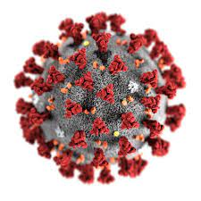
COVID-19
- Harika Devineni

Slide 2
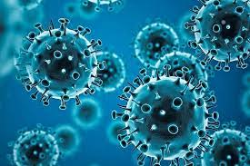
What is covid-19?
FLU LIKE ILLNESS
USUALLY MILD
VIRAL INFECTION
CAN LAST 7-14 DAYS
AFFECTING OLDER PEOPLE

Slide 3

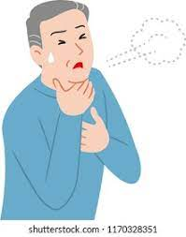
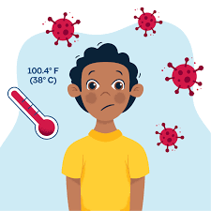
HOW DOES IT SPREAD?
SYMPTOMS
PERSON TO PERSON
CLOSE CONTACT
COUGHS AND SNEEZES

Slide 4
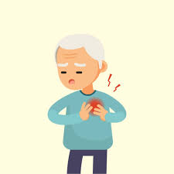
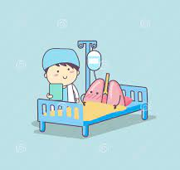
VULNERABLE GROUPS-Take more care!
ELDERLY>70
HEART DISEASE
LUNG DISEASE
DIABETES
KIDNEY & LIVER DISEASES

Slide 5


IN CASE OF SYMPTOMS
precautions
SELF ISLOATION FOR 7 DAYS
CONTACT DOCTORS
WEAR A MASK
WASH YOUR HANDS
KEEP A SAFE DISTANCE
AVOID LARGE GATHERINGS

Slide 6
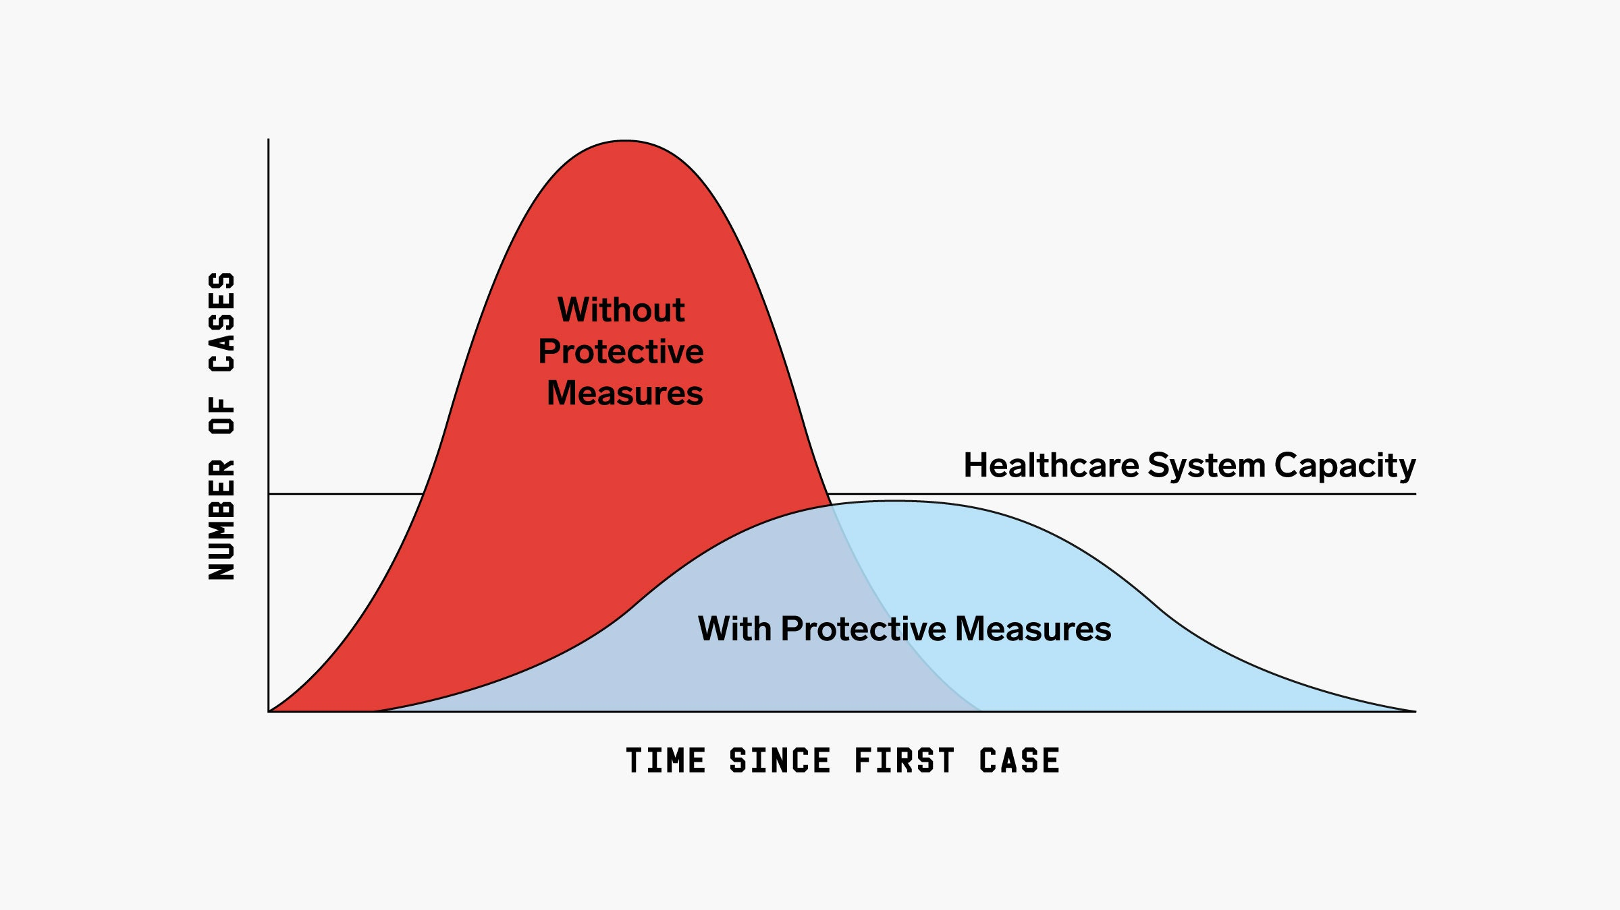
FLATTEN THE CURVE

Slide 7

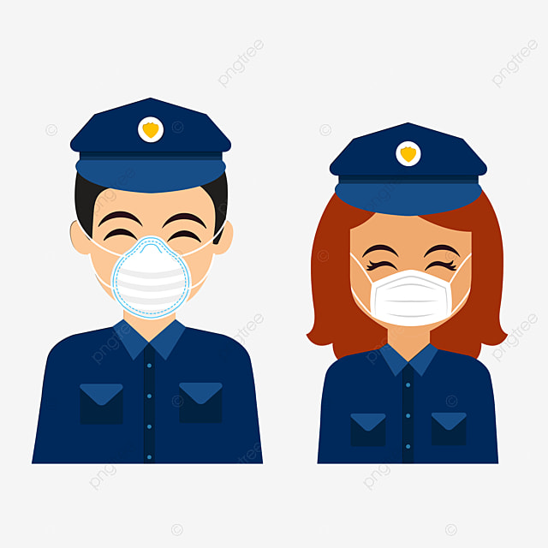

Salute to all front line workers

Slide 8


STAY HOME STAY SAFE
WE ARE ALL IN THIS TOGETHER

